Slide 1

EMPLOYEE ATTRITION
GROUP PROJECT BY TEAM: YULIIA, YENSI AND PAVLINA
DATASET: IBM HR Analytics Employee Attrition & Performance (kaggle.com)

Slide 2
WHAT IS ATTRITION RATE? Attrition rate = number of employees who left/total employees Attrition rate is a common and important analysis in HR analytics to see what factors are related to higher employee turnover.

Slide 3
DATASET`S GOALS AND QUESTIONS
What does the company need?
- An information about the employee attrition rate and attrition performance, based on IBM`s HR data.
- The analysis can help company better identified and understand the key factors affecting employee attrition and develop strategies to improve retention.
What type of problems are we trying to solve?
- How to prevent the impact of employee attrition on company productivity and which common features/categories that affect attrition the most.

Slide 4
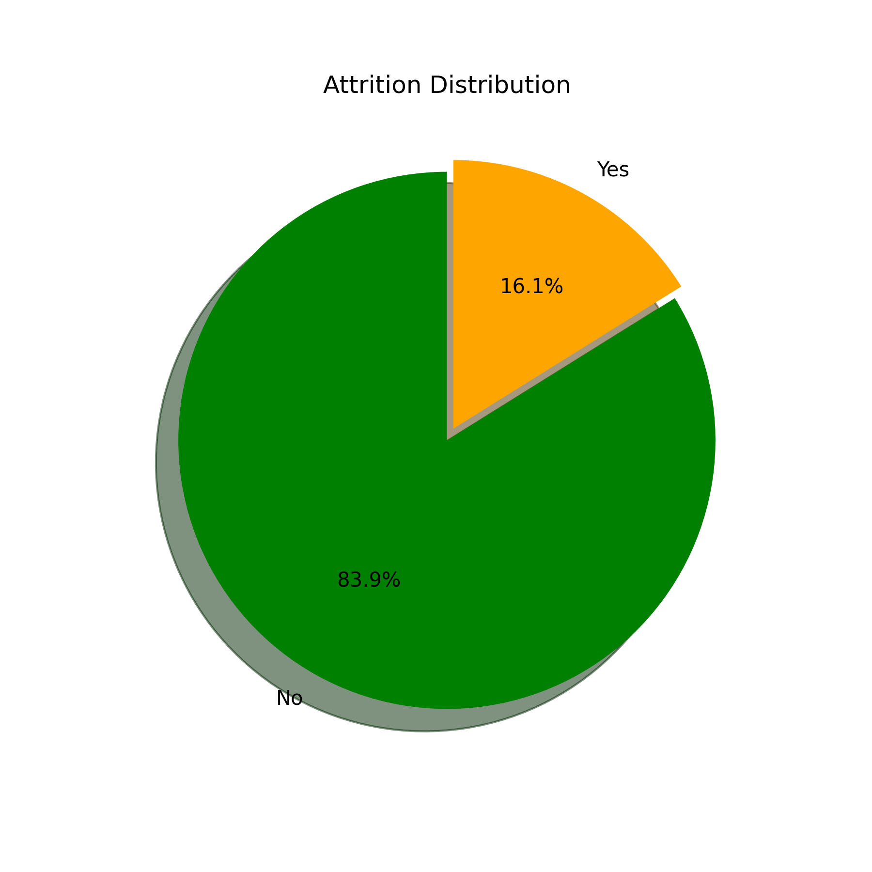
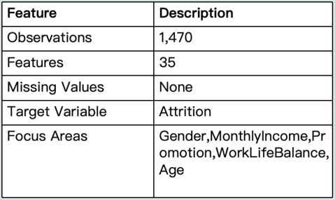

GENERAL VISION FOR DATASET

Slide 5
KEY VARIABLES
Age – Employee’s age
Attrition – Whether the employee left the company (Yes/No)
Department – Department the employee belongs to (Sales, R&D, HR)
Monthly Income – Monthly salary
Over Time – Whether the employee works overtime
Years At Company – Number of years at the company
Promotion - Years Since Last Promotion

Slide 6
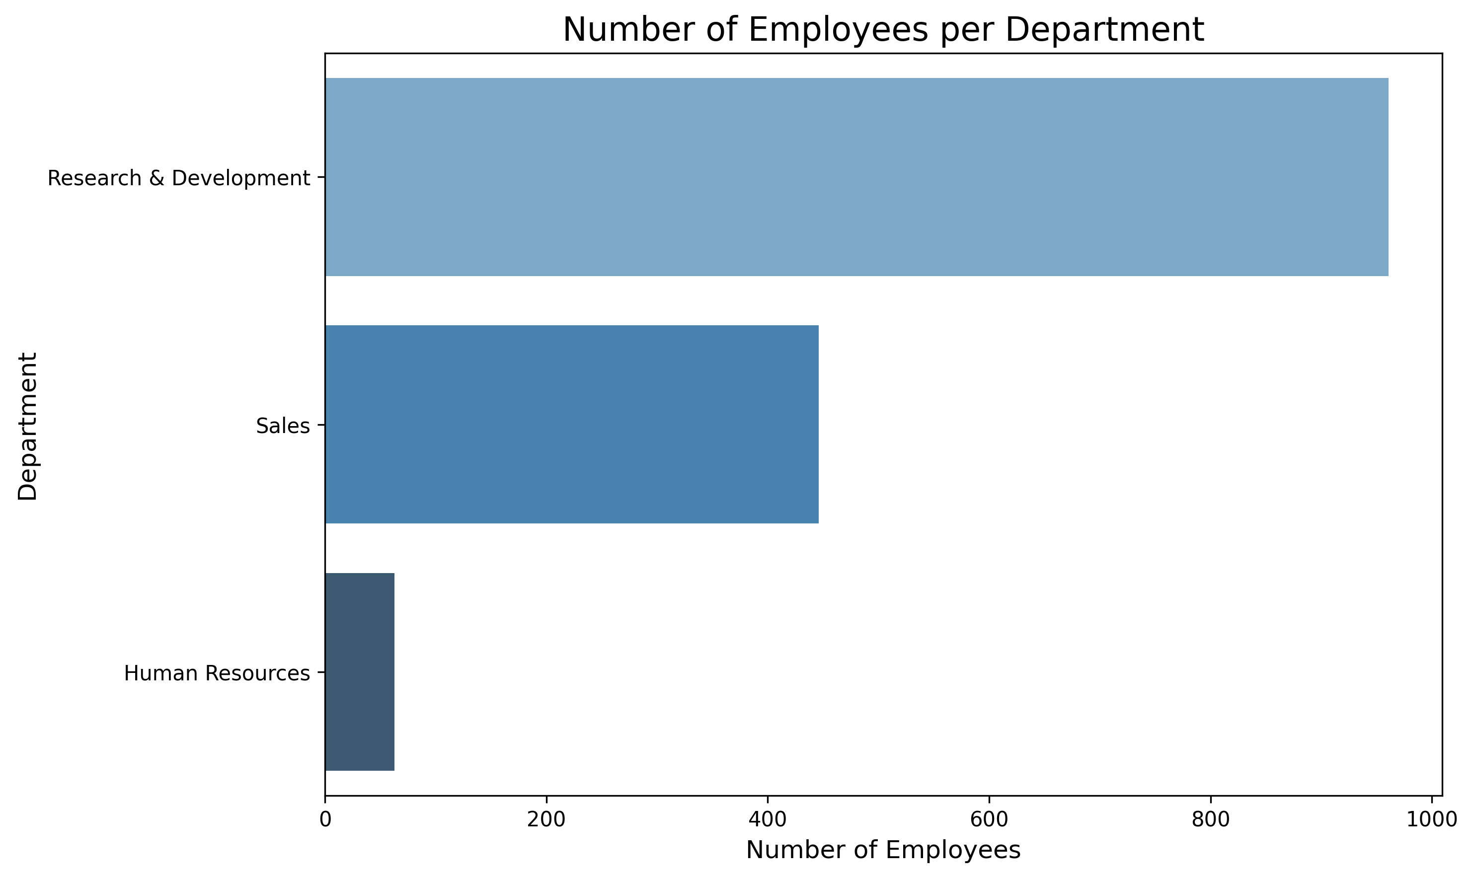
FOCUS FOR ANALYSYS
Since majority of employees are concentrated in the Research & Development and Sales departments, we will focus our further analysis on these two groups to ensure statistical reliability and clearer insights.

Slide 7

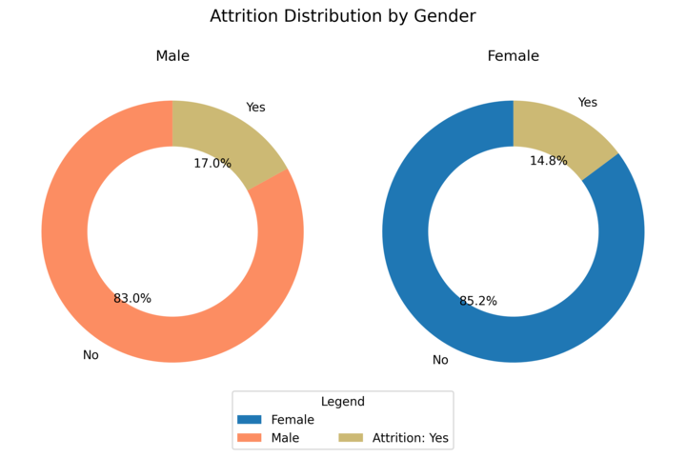
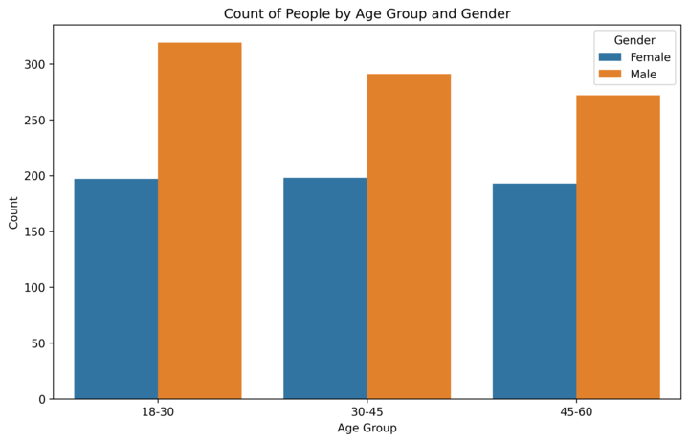
COUNT OF EMPLOYEES BY AGE AND GENDER AND ATTRITION DISTRIBUTION

Slide 8
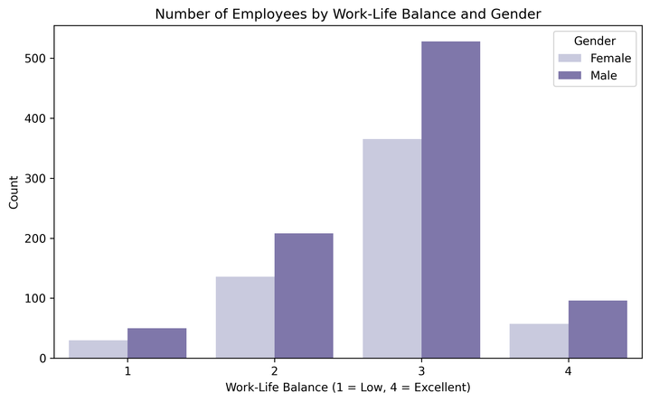
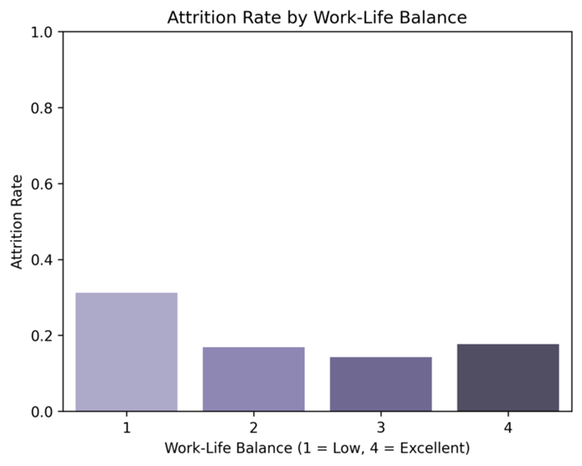
WORK-LIFE BALANCE

Slide 9
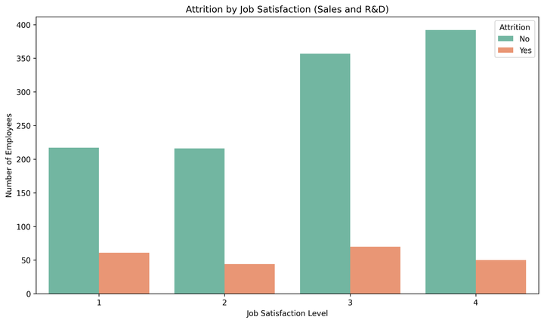
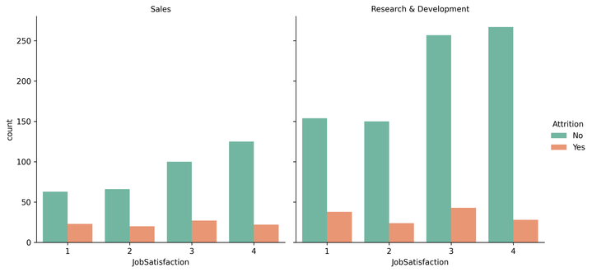
JOB SATISFACTION

Slide 10
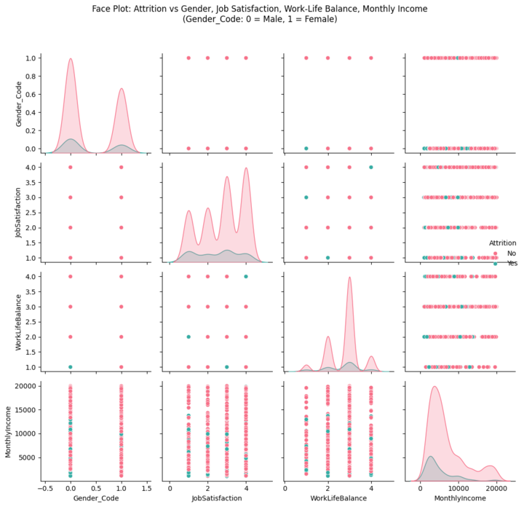
ATTRITION VS DIFFERENT CATEGORIES

Slide 11
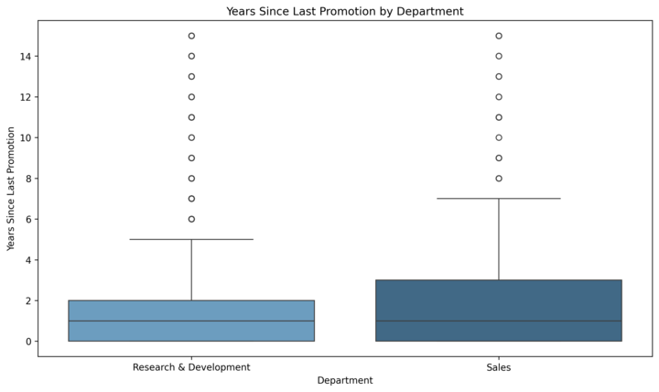
IMPACT OF THE ATTRITION

Slide 12
Conclusions and recommendations for optimizing HR strategies and reducing employee attrition rates.
Conclusions:
- This project focuses on employee attrition problems in IBM using the HR dataset.
- After deep analysis, we identified connections between various factors affecting employee turnover, for example: employees with a work-life balance index of 1 (low) are highly prone to leaving the company; male employees have higher attrition rate end female; time since the last promotion affects employee turnover rates - employees who haven`t been promoted for a long time are highly likely to leave the company.
- Employee turnover is a major challenge for companies, leading to higher costs and loss of talent. In general, dataset show us that the company maintains a healthy overall attrition rate.

